Slide 1
《算法分析与设计》
Analysis and Design of Computer Algorithms
中南大学计算机学院
School of Information Science and Engineering
Central South University
主讲：李敏
联系方式：limin@mail.csu.edu.cn
15257578@qq.com
课程学习交流群： 709290112

Slide 2
递归算法的数学分析
例：对于任意非负整数n，计算F(n)=n!的值。
n(n-1)! , n>1
F(n)=
1 , n=1
1 ,n=0
算法 F(n)
//递归计算n!
//输入：非负整数n
//输出：n!的值
if n=0 retuen 1
else return F(n-1)*n
M(n-1)+1 , n≥1
M(n)=
0 , n=0
M(n)=M(n-1)+1
=[M(n-2)+1]+1=M(n-2)+2
=[M(n-3)+1]+2=M(n-3)+3
……
=[M(n-n)+1]+n-1=n

Slide 3
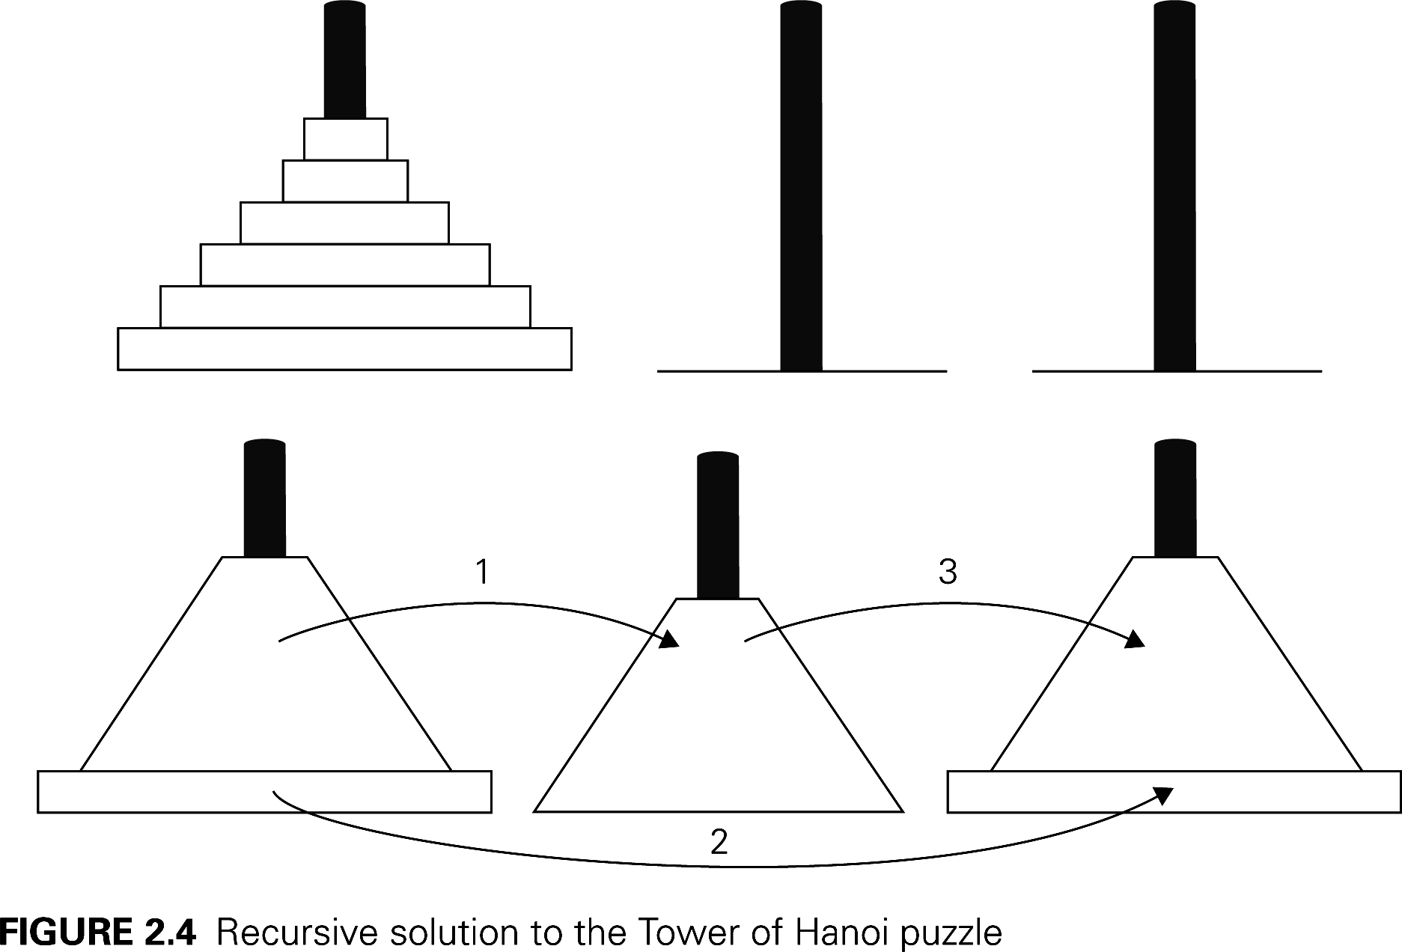
The Towers of Hanoi Puzzle
2M(n-1)+1 , n>1
M(n)=
1 , n=1
M(n)=2^{n}-1
我们应该谨慎使用递归算法，因为他们的简洁可能会掩盖他们的低效率。
© School of Computer Science and Technology, CSU

Slide 4
Quick sort
Qsort (A, i, j)
if (i==j) then return
pick a pivot x;
i₀= i; j₀ = j ;
While i₀ ≤ j₀ do
if A[i₀] ≤ x then i₀++;
else swp A[i₀] and A[j₀]; j₀--;
5. Qsort (A, i, j₀);
6. Qsort (A, i₀, j);
Worst case:
O(n²)
Average case:
O(nlogn)
Notes:
Merge sort :是最经典的算法，由计算机先驱之一John Von Neumann在1945年发明的。

Slide 5
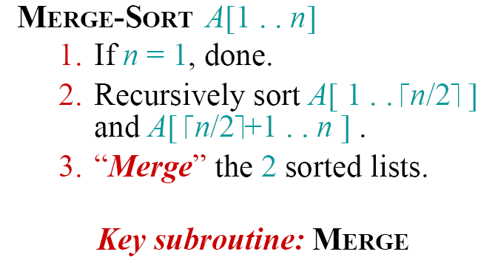
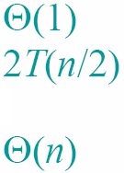
Merge sort：
Merge (B1,B2)
i₁= 1, i₂=1, i=1
While i₁≤ |B1| and i₂≤ |B2| do
if B1[i₁] ≤ B2[i₂]
then A[i]=B1[i₁]; i₁++
else A[i]=B2[i₂]; i₂++;
i=i+1;
if i₁> |B1| then
for k= i₂ to |B2| do
A[i++]=B2[k];
else for k= i₁ to |B1| do
A[i++]=B1[k];
Notes:
Merge sort :是最经典的算法，由计算机先驱之一John Von Neumann在1945年发明的。

Slide 6
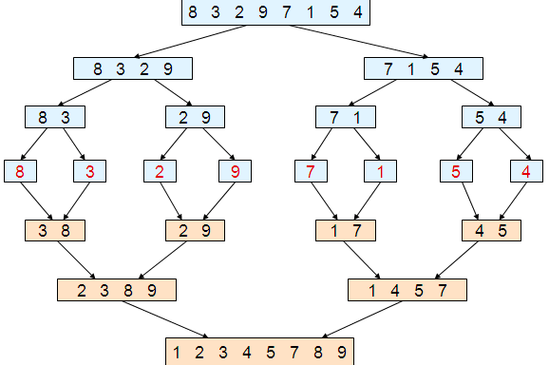
Merge sort：
Notes:
Merge sort :是最经典的算法，由计算机先驱之一John Von Neumann在1945年发明的。

Slide 7
分析递归算法效率的通用方案
决定用哪个参数作为输入规模的度量
找出算法的基本操作
检查对相同规模的输入，基本操作的执行次数是否相同，如果不同，必须对最差、平均及最优效率单独研究
建立一个递推关系式及相应的初始条件
求解这个递归关系式，或者至少确定解的增长次数

Slide 8

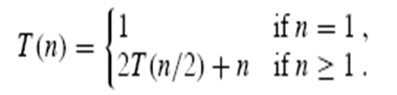

Recurrence(递归）
A recurrence is a function is defined in terms of
  one or more base cases, and
  itself, with smaller arguments(参数）.
Examples:

Slide 9
Solving recurrences
A few tricks analyzing recurrence relation:
  Guessing: Substitution (代入法）
  Recursion tree（递归树）
  Master method（主定理/公式法）
  母函数法
  差分方程法

Slide 10
Intelligent guesses
Guessing may seem like a nonscientific method, but it works well for a wide class of recurrence relations.
It works even better when we are trying to find only an upper bound ( O () notation)
  (Proving a certain bound is easier than computing the bound.!)

Slide 11
1. Substitution method（代入法）
Substitution method
  Guess the form of the solution.
  Verify by induction(数学归纳）
  Solve for constants.
Example1: T(n) = 4T(n/2) + n， T(1) = Θ(1)
Guess： O(n³) .
Assume that ：T(k) ≤ ck³ for k < n.
Prove T(n) ≤ cn³ by induction.

Slide 12
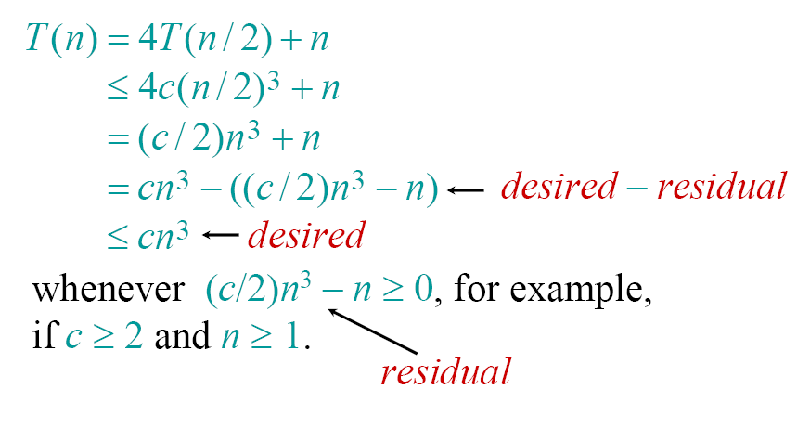
Example of substitution
Notes:
Desired :期待，期望，residual:残余

Slide 13
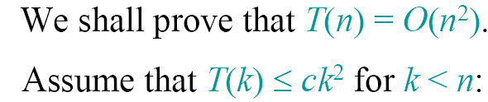

A tighter upper bound?
      T(n)=4T(n/2)+n
      ≤4 c(n/2)² +n=cn²+n
      ≤cn²
=O(n²） (??)
No choice of c > 0.

Slide 14
Try: n²logn

Slide 15
Example2: T(2n) ≤ 2T(n) + 2n -1, T(2) = 1.
  Try n²: T(n) = O(n²)
    T(n) ≤ cn²
      T(2) = 1 ≤ c(2²) = 4c, (c ≥ ¼).
      T(2n) ≤ 2T(n) + 2n – 1 (by definition)
      ≤ 2cn² + 2n – 1
      (by substitution: T(n) ≤cn²)
      ≤ 2cn² + 2n
      ≤ 2cn² + 2cn² (n >2)
      = 4cn²
      = c(2n)²
    Note: The gap between 2cn² + 2n -1 and 4cn² is too large!
    Conclusion: n² is probably too large!

Slide 16
  Try : T(n) = O(n)
    T(n) ≤ cn
      T(2) = 1 ≤ c.2 = 2c, (c ≥ 1/2).
      T(2n) ≤ 2T(n) + 2n – 1
      ≤ 2cn + 2n – 1 (substitution)
      ≤ 2cn+ (2n – 1)
      > 2cn (2n -1 > 0, when n > 2)
    conclusion: cn is too small!

Slide 17
  Try : T(n) = O(nlog₂n)
  Assume: T(n) ≤ cnlog₂n
      T(2) = 1 ≤ 2c, (c ≥ 1/2).
      T(2n) ≤ 2T(n) + 2n – 1
      ≤ 2cnlog₂n + 2n – 1 (substitution)
      ≤ 2cnlog₂n + 2n
      =2cnlog₂n+2nlog₂2
      ≤2cnlog₂n+2cnlog₂2 (c>=1)
      =c(2n)log₂(2n)

Slide 18
Common mistakes!!
    Guess the solution is O (f(n)) and substitute O (f(n)) for T(n)
    Example: T(2n) ≤ 2T(n) + 2n -1
    Guess: T(n) = O (n)
    T(2n) ≤ 2T(n) + 2n -1
    ≤ 2 O (n) + 2n -1
    =O(n)
    The O() notation cannot be used in this way!
    We do not care about constants in the end, but we cannot ignore them throughout the proof.

Slide 19

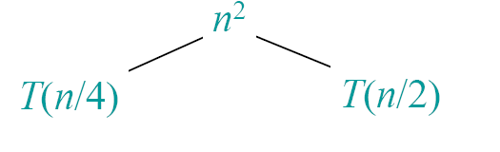
Recursion tree(递归树）

Slide 20
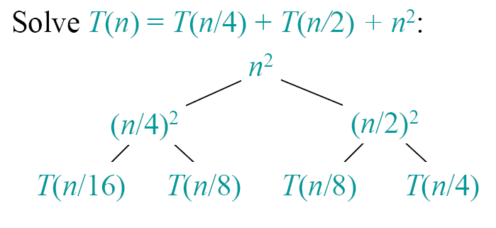
Example of recursion tree

Slide 21
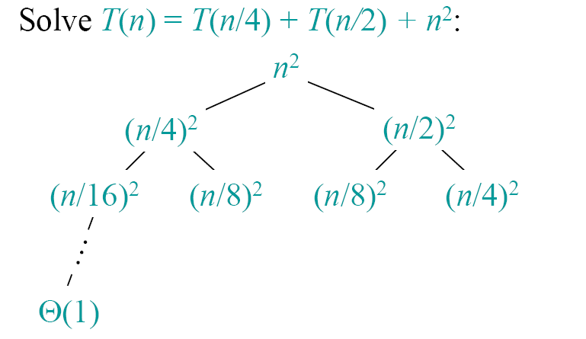
Example of recursion tree

Slide 22
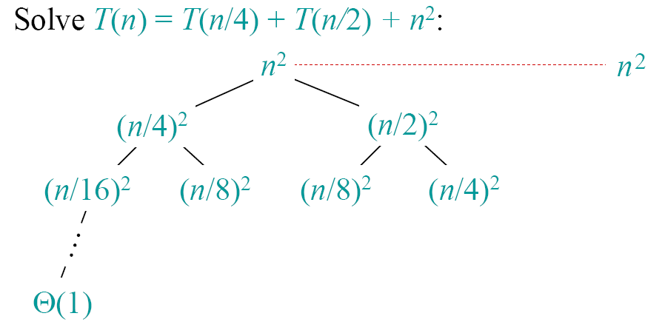
Example of recursion tree

Slide 23
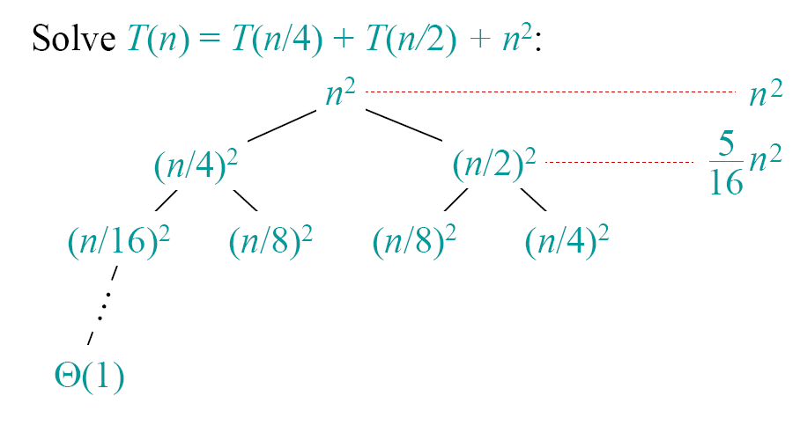
Example of recursion tree

Slide 24
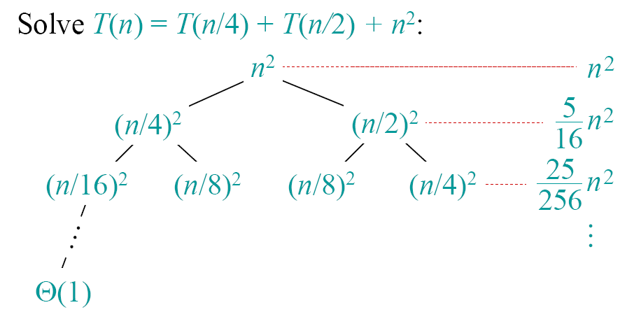
Example of recursion tree

Slide 25
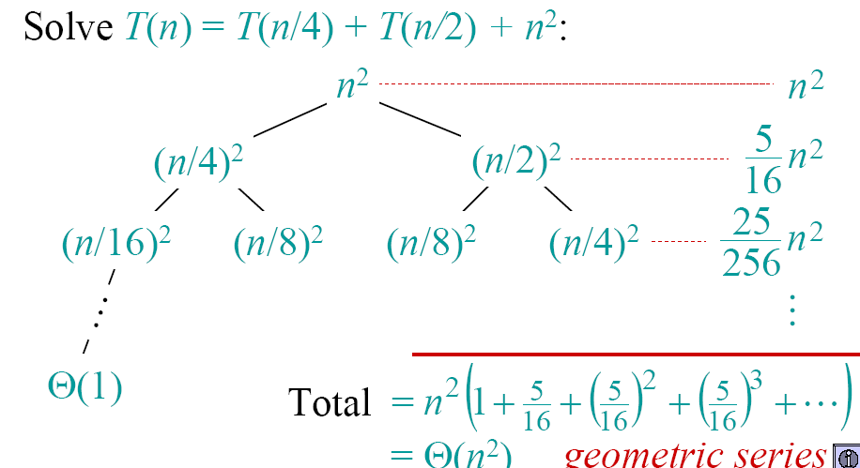
Example of recursion tree

Slide 26
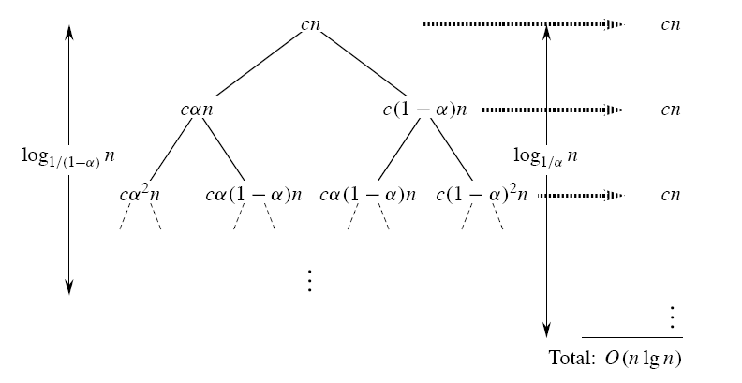
T(n)=T(αn)+T((1- α)n)+cn

Slide 27
Proof by recurrence-tree (课堂练习）
The tree of merge sort
T(n)=2T(n/2)+cn
T(n)=2T(n-1)+1

Slide 28
The master method
The master method applies to recurrences of the form:
T(n) = aT(n/b) + f (n) ,
where a ≥ 1, b > 1, and f (n) is asymptotically function such as n, n²….
asymptotically function:渐近函数

Slide 29
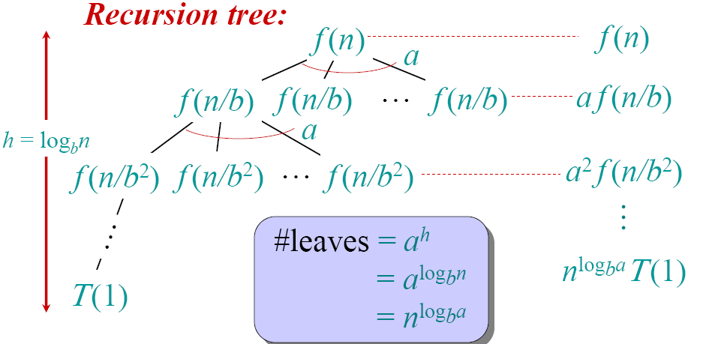
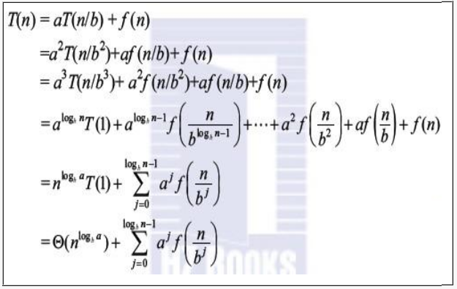
Idea of master method (theorem):
T(n) = aT(n/b) + f (n)

Slide 30

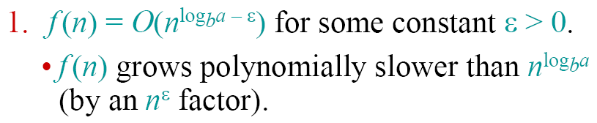

Three common cases：

Slide 31
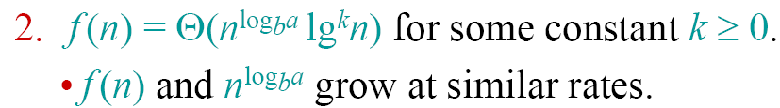
Three common cases：

Slide 32
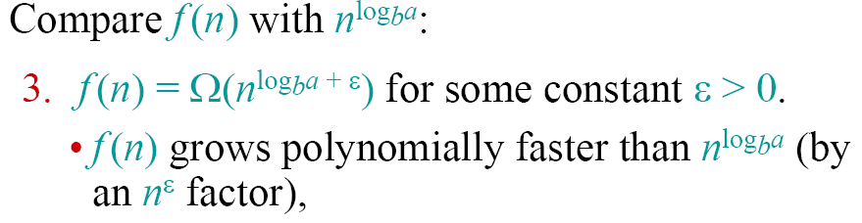

Three common cases：

Slide 33


Example:

Slide 34


Example:

Slide 35


Example:

Slide 36
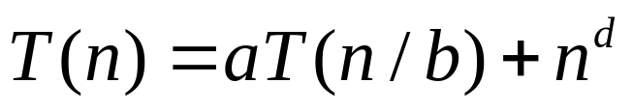
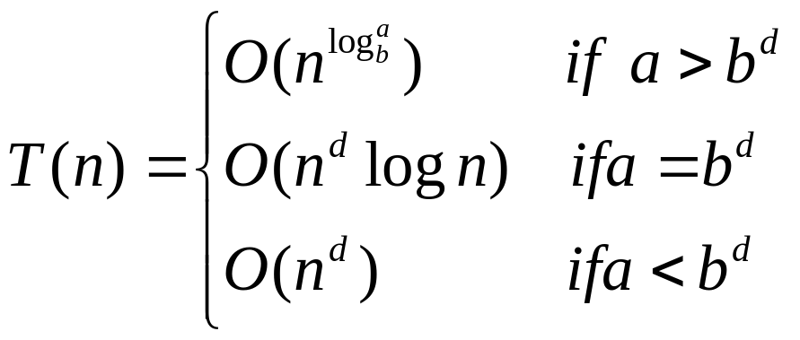
  When f(n)=n^{d}
  For

Slide 37

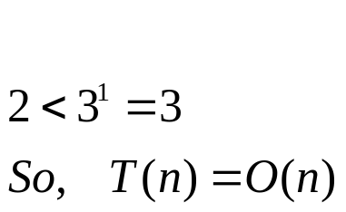


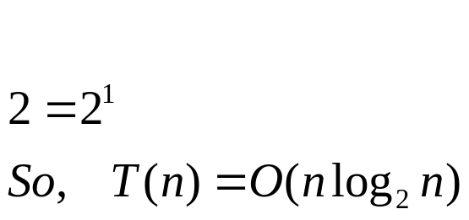

Exampls
    1.
      Solution:
    2.(Mergesort):
      Solution:

Slide 38
Fibonacci numbers
The Fibonacci numbers:
  0, 1, 1, 2, 3, 5, 8, 13, 21, …
The Fibonacci recurrence:
  F(n) = F(n-1) + F(n-2)
  F(0) = 0
  F(1) = 1

Slide 39
Solving aX(n)+bX(n-1)+cX(n-2)=0
Set up the characteristic equation (quadratic)
ar² + br + c = 0
Solve to obtain roots r₁ and r₂
General solution to the recurrence
  if r₁ and r₂ are two distinct real roots:
  if r₁ = r₂ = r are two equal real roots:
  X(n) = αr^{n} + βnr ^{n}
Particular solution can be found by using initial conditions
X(n) = αr₁^{n} + βr₂^{n}

Slide 40
Application to the Fibonacci numbers
F(n)=F(n-1)+F(n-2) or F(n)-F(n-1)-F(n-2)=0
Characteristic equation:
Roots of the characteristic equation:
General solution to the recurrence:
Particular solution for F(0) =0, F(1)=1:

Slide 41
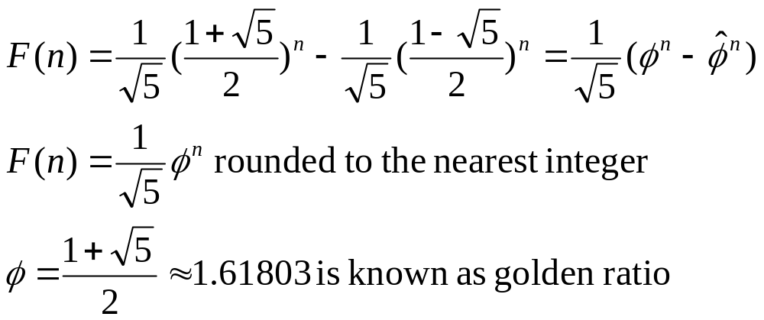
Golden Ratio

Slide 42
How to choose these methods?
Analyzing recurrence relation:
Recursion tree
Master method
Characteristic equation
T(n) = aT(n/b) + f (n)
(1) As long as f(n) exists, Recursion tree can be used.
(2) For master method, b must larger than 1.
if b>1, T(n) is polynomial.
if b=1, T(n) is always exponential. M(n) = 2M(n – 1) + 1
(3) T(n) = a₁T(n-c₁) + a₂T(n-c₂)+…+a_{i}T(n-c_{i})
b=1 and no f(n)

